Slide 1

Ice Crew
Make it happen!

Slide 2
The Game
The Legend of Zelda a Link to the Past
A game that we have all played and liked.
It fits our idea of making a roguelike game.
We will keep:
Main plot, Combat style, Puzzle solving, ...
We will change:
Enemies & objects.
Adapt the Rogue-like mechanics.

Slide 3
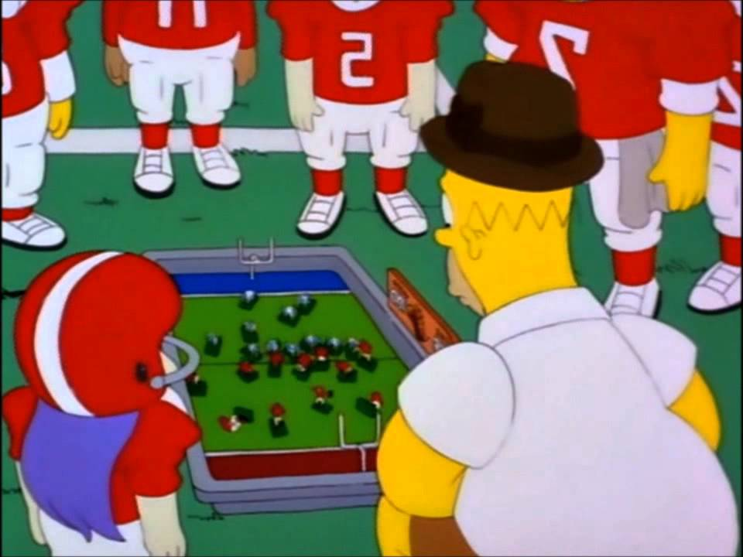
Lead
Provide a positive environment for everyone.
High and constant feed-back.
Constant communication.
Permanent cooperation.

Slide 4
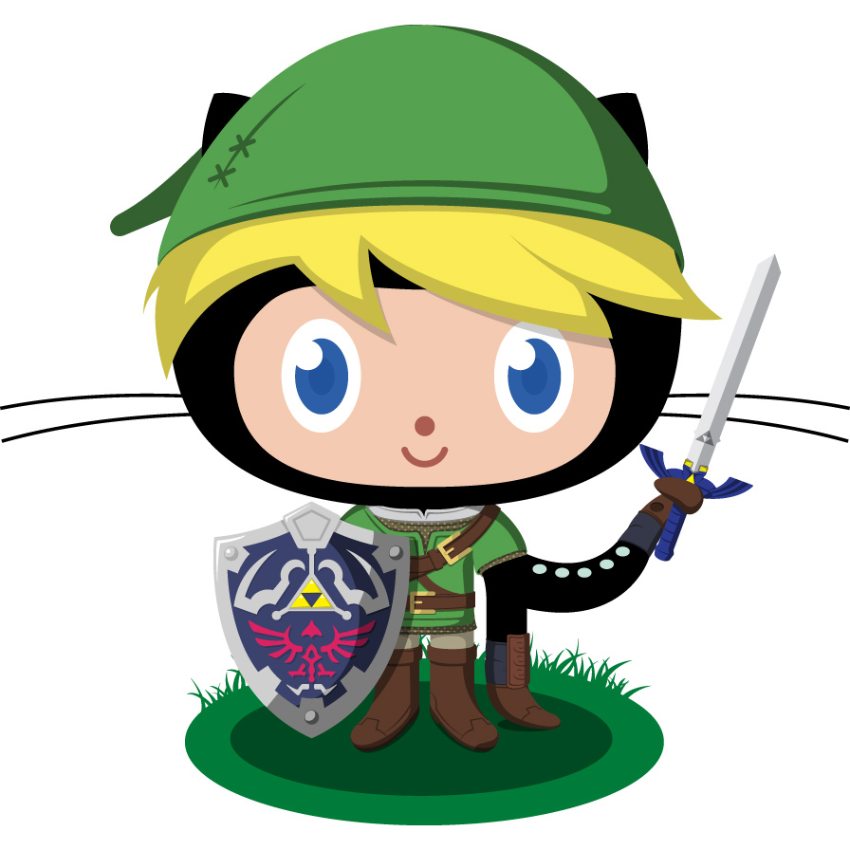
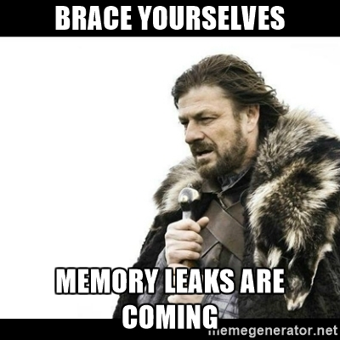
Code
General goals
Keep Github organized
Make everybody be comfortable with the code
Be responsible of solving the bugs
End with all memory leaks

Slide 5
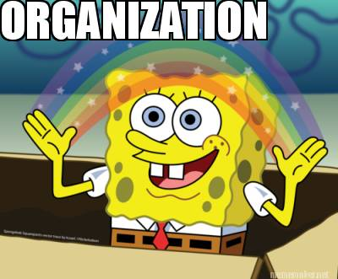
Code
Organization:
WorkFlow
Work with the latest commit
Use branches
//Use Comments
Technical Document
Guide to follow
Variable and Function names with sense

Slide 6

Code
How to fulfill my goals
Make small commits
Help the other members of the team
Be open-minded to the team suggestions

Slide 7


Management
Achieve every goal on time.
Make sure everybody has work to do.

Slide 8
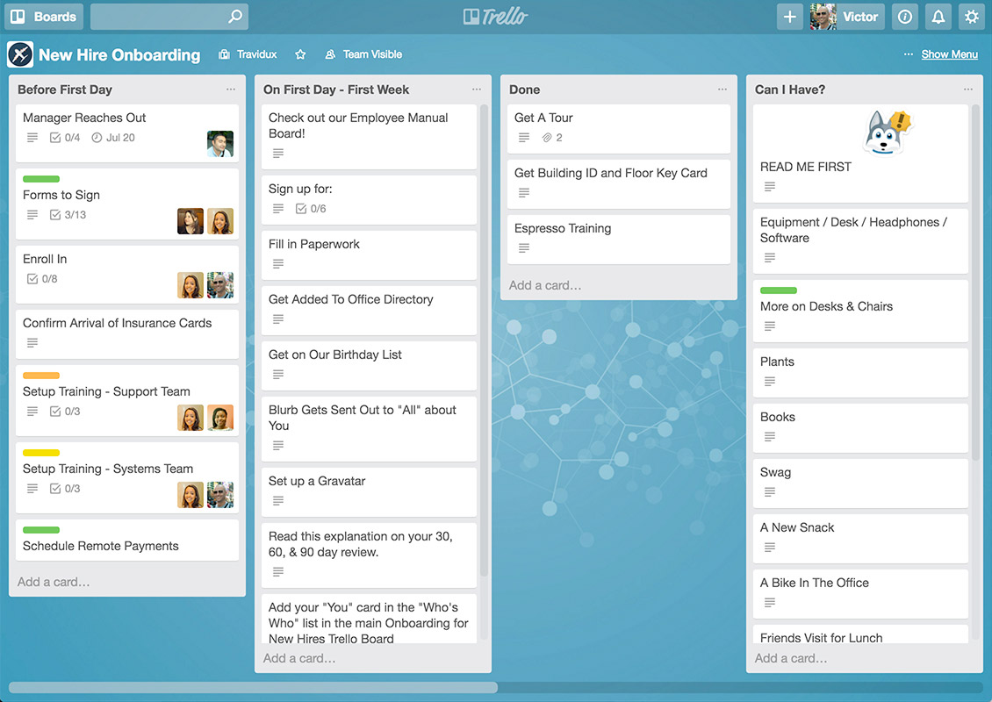
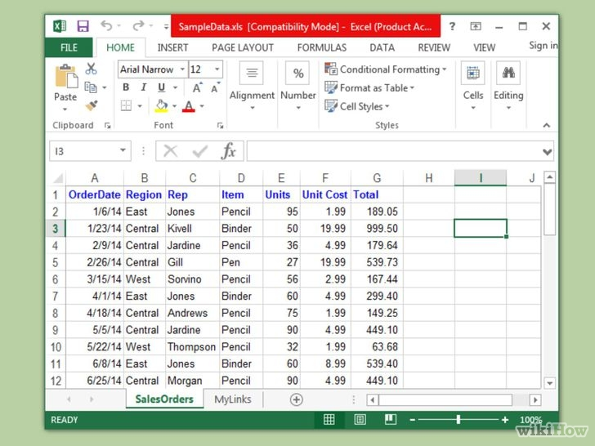
Management
Meeting every Monday and Thursday.
Every day minimum until 14:30.
Trello & Excel.
Using Github, Slack & Discord.

Slide 9
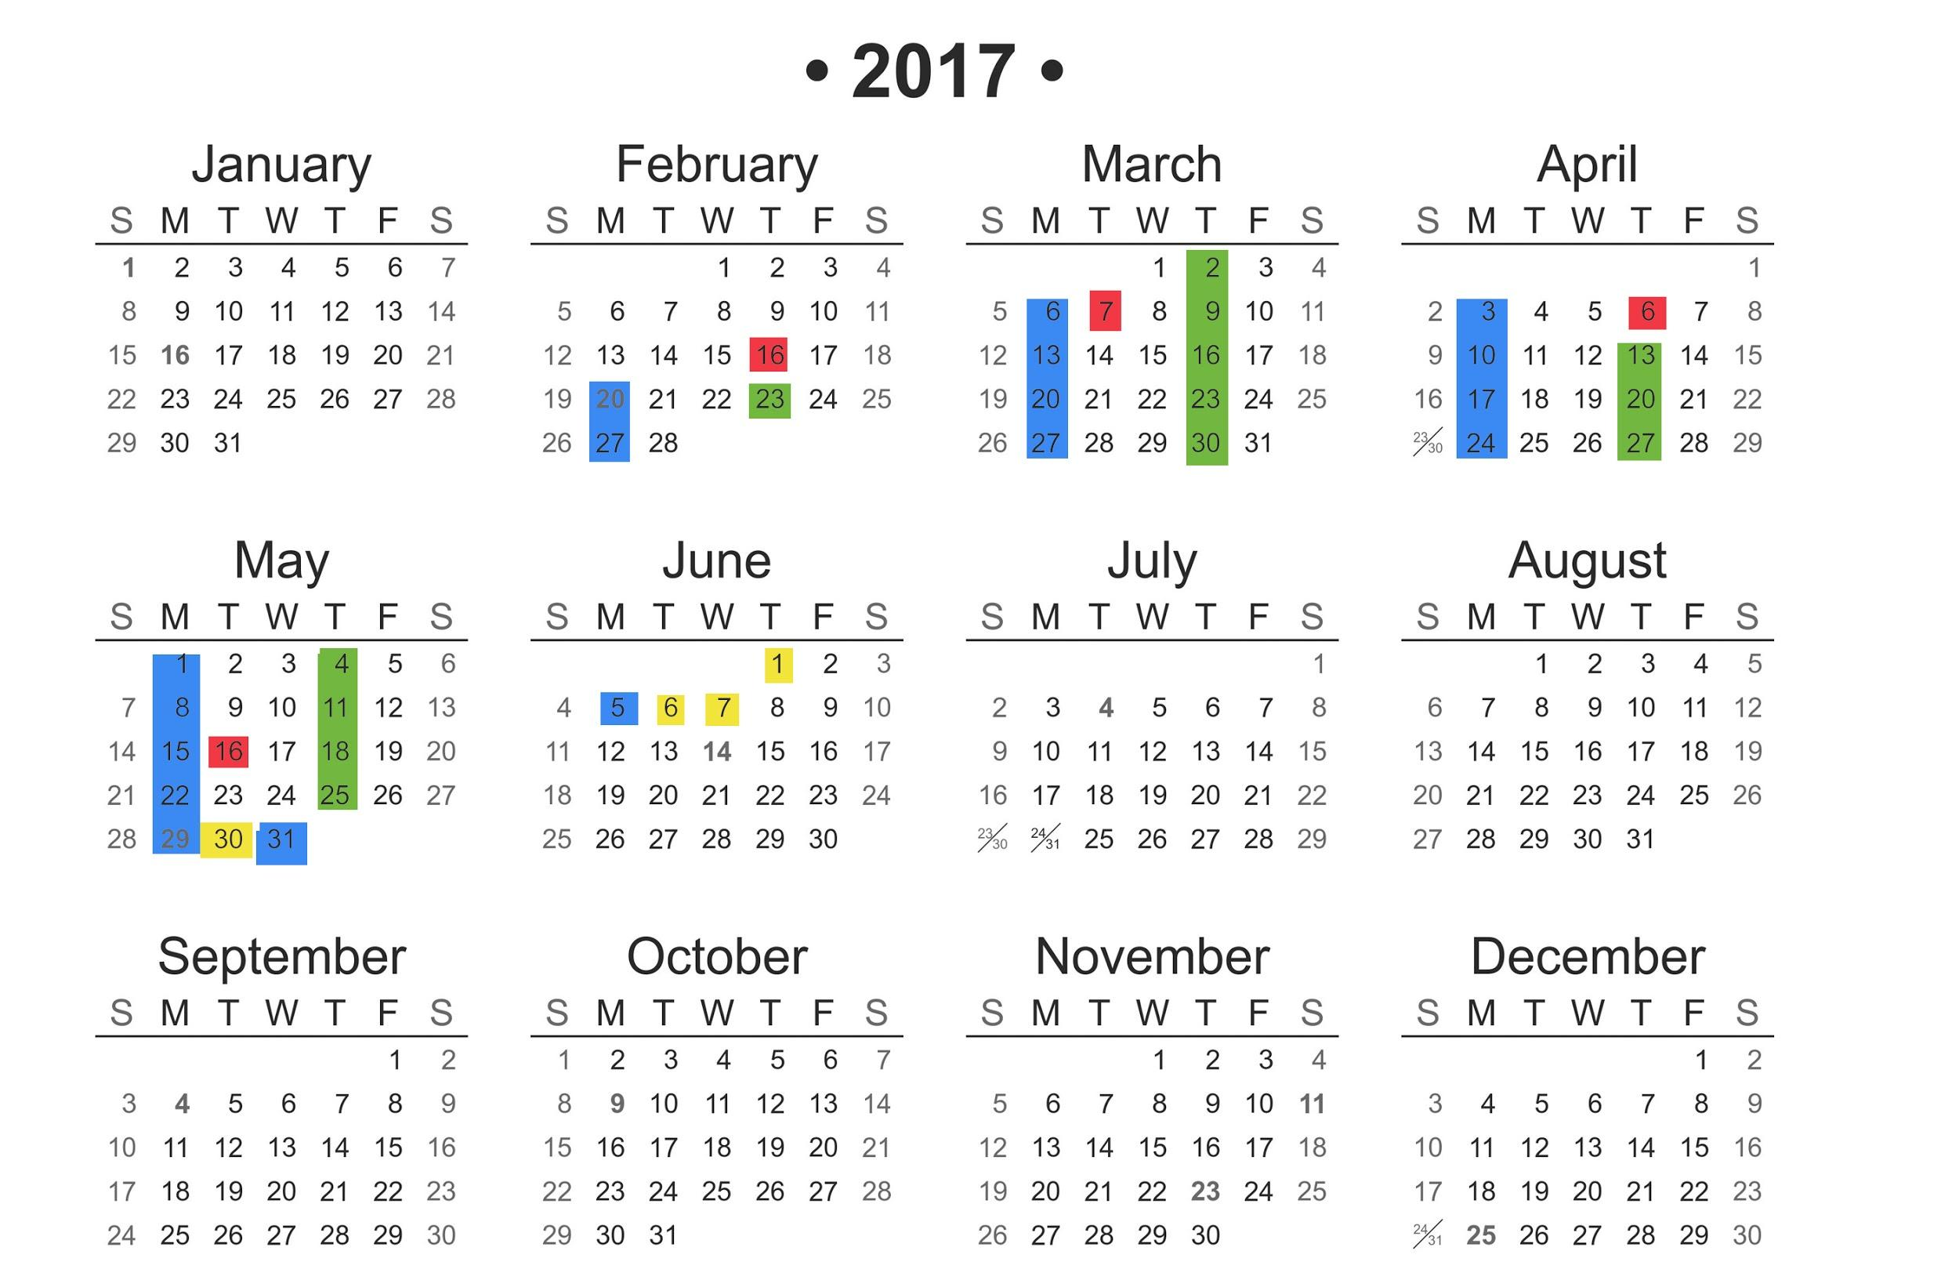
Meetings
Deliveries
Online review
Gold days

Slide 10
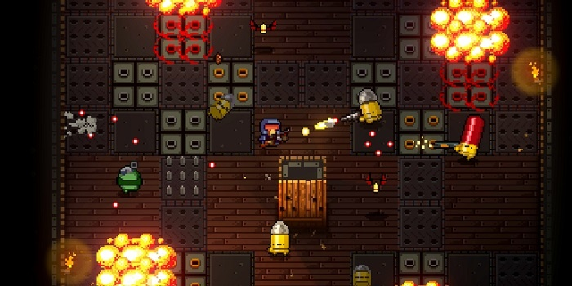
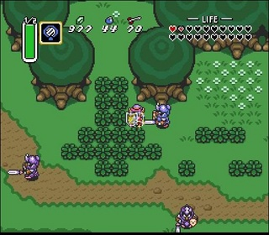
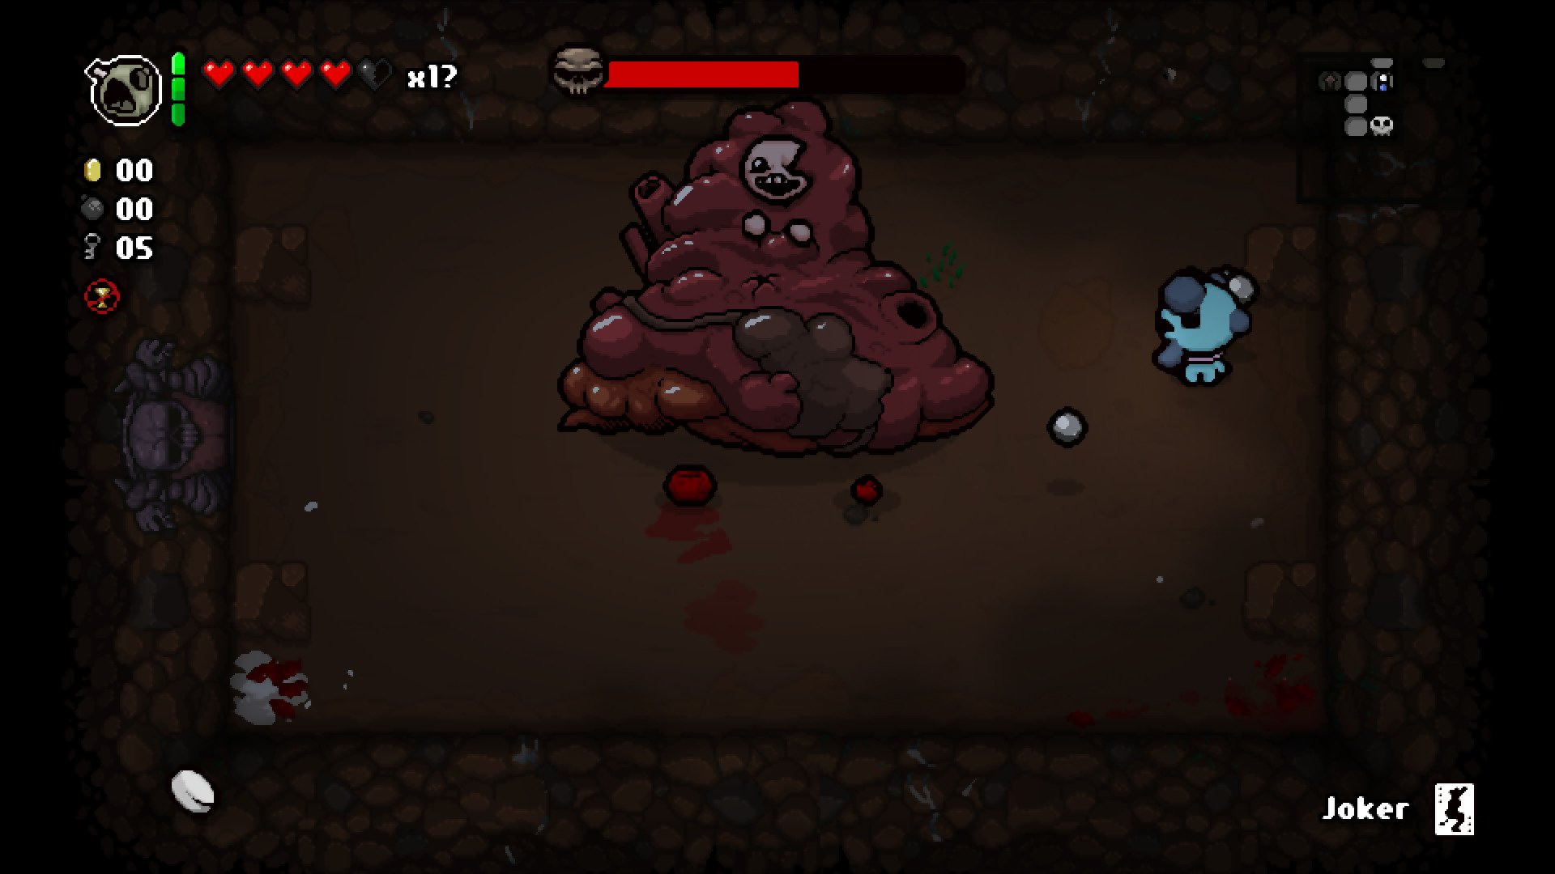
Design
Adventure + RPG + Rogue-Like.
Same Essence, even more Action.
Fast-Paced Combat.
Keep & Adapt the Puzzles.

Slide 11
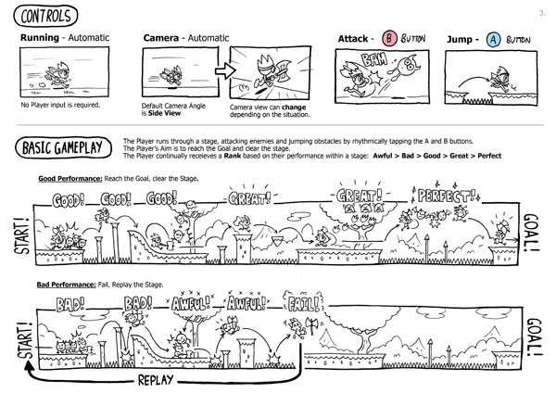

Design
Heavy Visual Aspect
Sketches, Concepts, References, ...
Manageable Documentation
Clear & Understandable Concepts
Must Ease other Roles’ Work
Workflow
Brainstorm/Inspiration > Idea > Documentation + Sketch > Prototype > Tests
Always Open to New Concepts

Slide 12
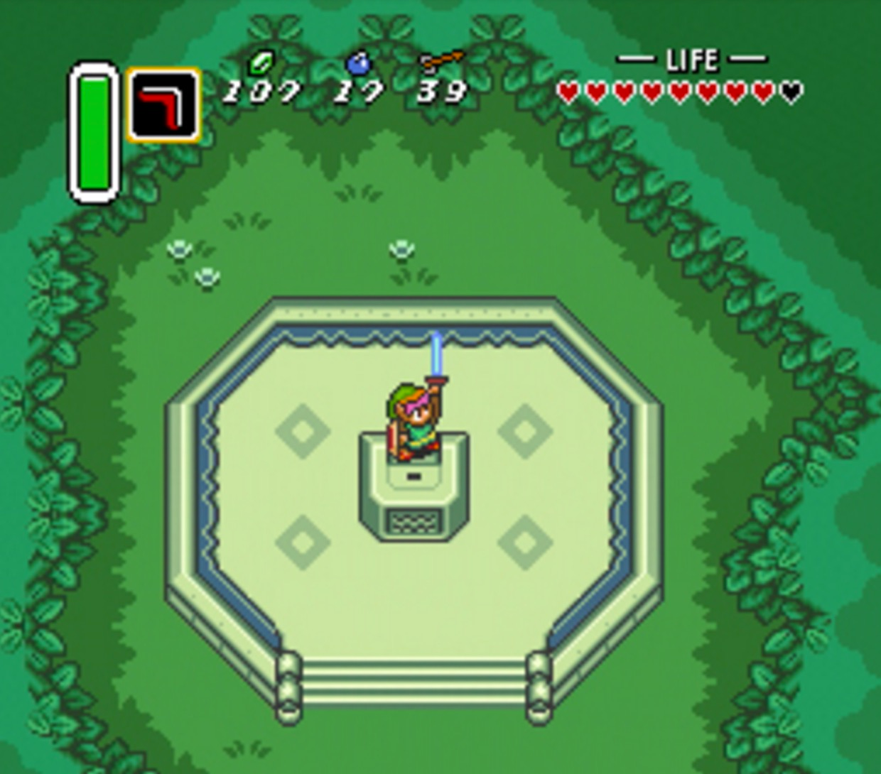
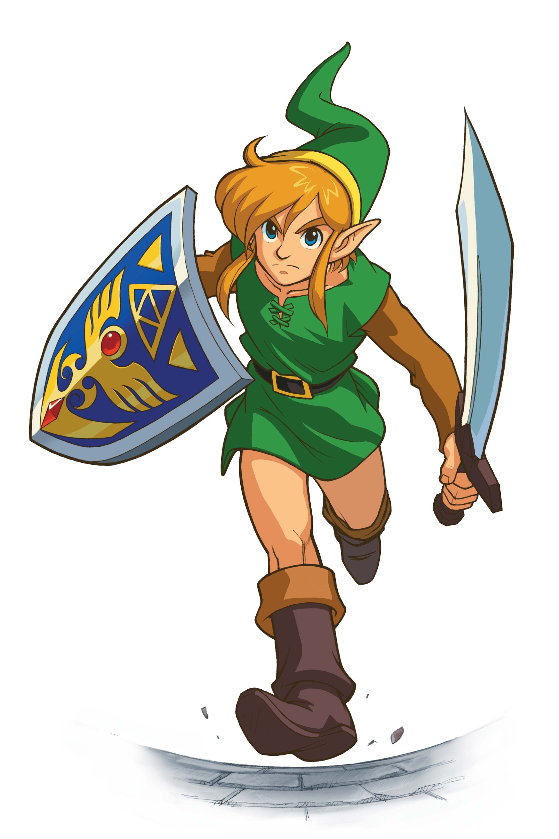
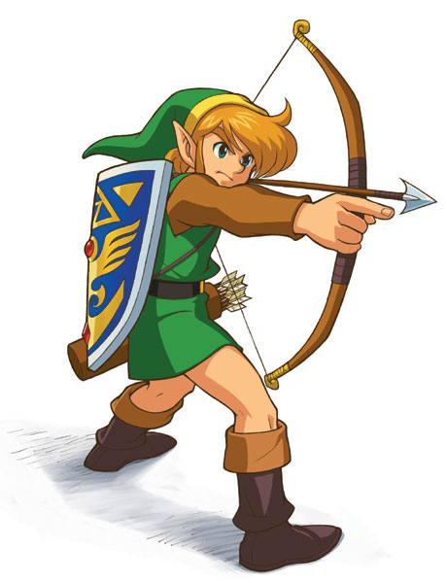
Art & Audio
Keep it and innovate it
Original and new
Sprites, soundtracks and sound effects
Organisation and process
Keep track of needed sprites
Concept arts for new features
Make sure everything matches
Respect the original

Slide 13
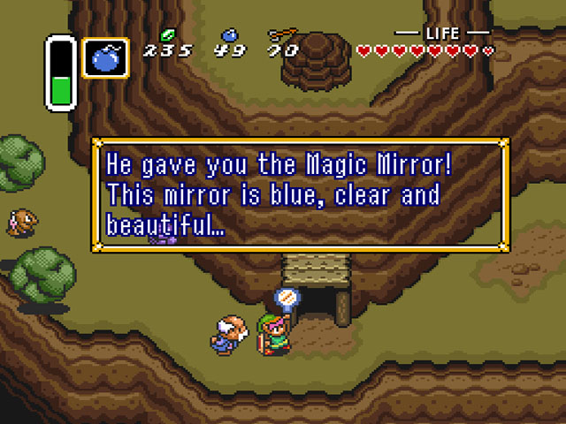
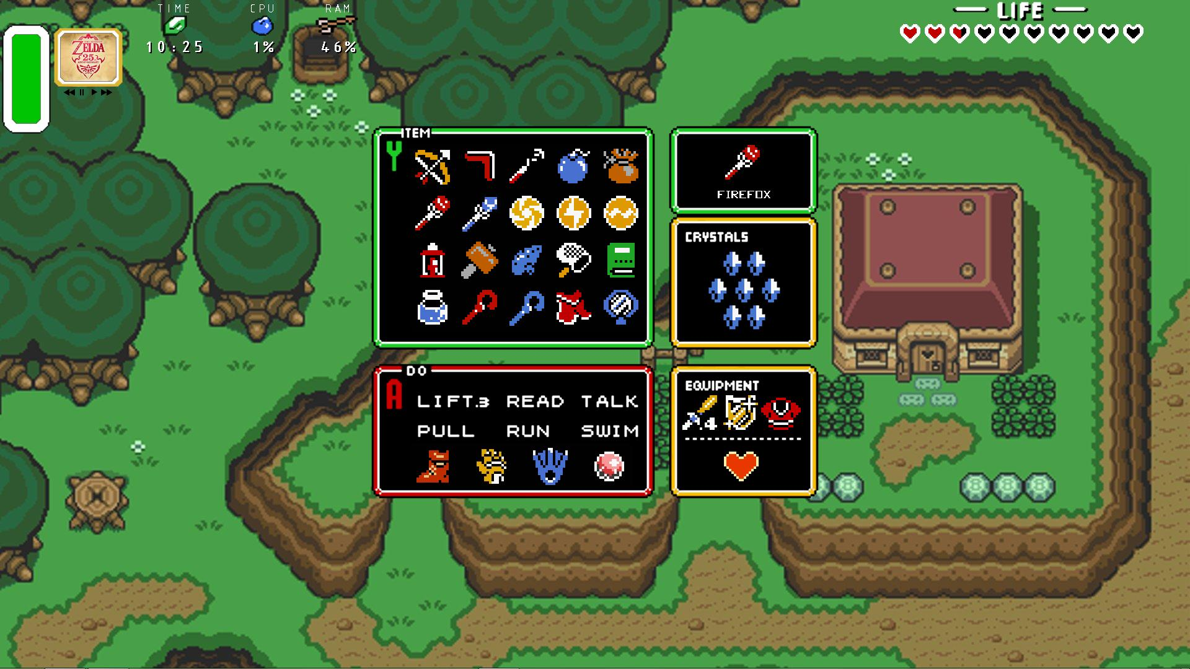
User Interface
General Goals:
Have a solid and easy to use UI system (console also).
No changes from the original User Interface.
Gamepad*

Slide 14
User Interface
Ways to organize:
UML
All team members know how to use the UI system.
Have clear all changes in the UI that could be made in advance.
Responsibilities fulfilled:
Make sure with the QA responsible that all UI elements are correctly working.
All possible new UI elements are intuitive for the player and are usable.

Slide 15


Quality Assurance
Organize Tracking of Technical Issues
Organize test sessions
Comments must be on point
Comprehensible template for:
Internal - GitHub Issues
External - Google Forms
Issues Revision

Slide 16

Quality Assurance
Progress
Organize Milestones by:
Social Media Update
Minor Stable Builds
Delivery Builds
Update Status of current milestones

Slide 17



Contact Us
IceCrew https://www.facebook.com/IceCrew-1106804352762216/
Twitter @IceCrew_
e-mail icecrewupc@gmail.com
Make It Happen!

